Slide 1

ELECTRIC VEHICLE POPULATION DATA ANALYZE
Presentor:
Sean Walker, Miles ZhengFerrari, Raj Rahul Parekh, Kaiyin Chen
CS661 Python Programming (Fall 2024)
Notes:
Kai

Slide 2
Abstract
Electric Vehicles (VEs) are the collective term for plug-in hybrid electric vehicles (PHEVs) and all electric-vehicles. They are capable of drawing electricity from off-board electrical power source and storing the energy in the batteries.
In this research, we used EDA and Python pandas methods to analyze the use of electric vehicles in Washington State and to analyze electric vehicles info and vehicle owners geographic information.
Questions we looked to answer today
What kinds of electric vehicles are used in Washington State?
Where are they located?
The mileage they can achieve?
Notes:
Kai

Slide 3

Introduction - Electric Vehicle
Alternative Fuel Data Center
Electric vehicles and hybrid vehicles offer reduced operating costs, fuel savings, and environment benefits.
The electricity generation for the operation of all electric vehicle produces 53% less emissions than the tailpipe emissions from the operation of a gasoline vehicle.
Under various electric vehicles adoption scenarios, estimates a 22% to 36% decrease in greenhouse gas emission reductions.
By 2045, hybrid electric vehicles could achieve a 43% to 81% improvement in fuel economy and Plug-in hybrid electric vehicles could achieve a 73% to 96% improvement in fuel economy.
In 2019 Washington State introduced tax credit for new or used hybrid vehicles that utilized clean energy.
Notes:
Kai

Slide 4
HEVs vs. PHEVs
Hybrid Electric Vehicles (HEVs)
Plug-in hybrid electric vehicles (PHEVs)
Typically use less fuel than similar conventional vehicles because they employ electric-drive technologies to boost vehicle efficiency through regenerative braking - recapturing energy otherwise lost during braking.
Also including all-electric vehicles, it referred to as battery electric vehicles (BEVs), are both capable of being powered solely by electricity.
Notes:
All forms of electric vehicles (EVs) can help improve fuel economy, lower fuel costs, and reduce emissions.
Kai

Slide 5
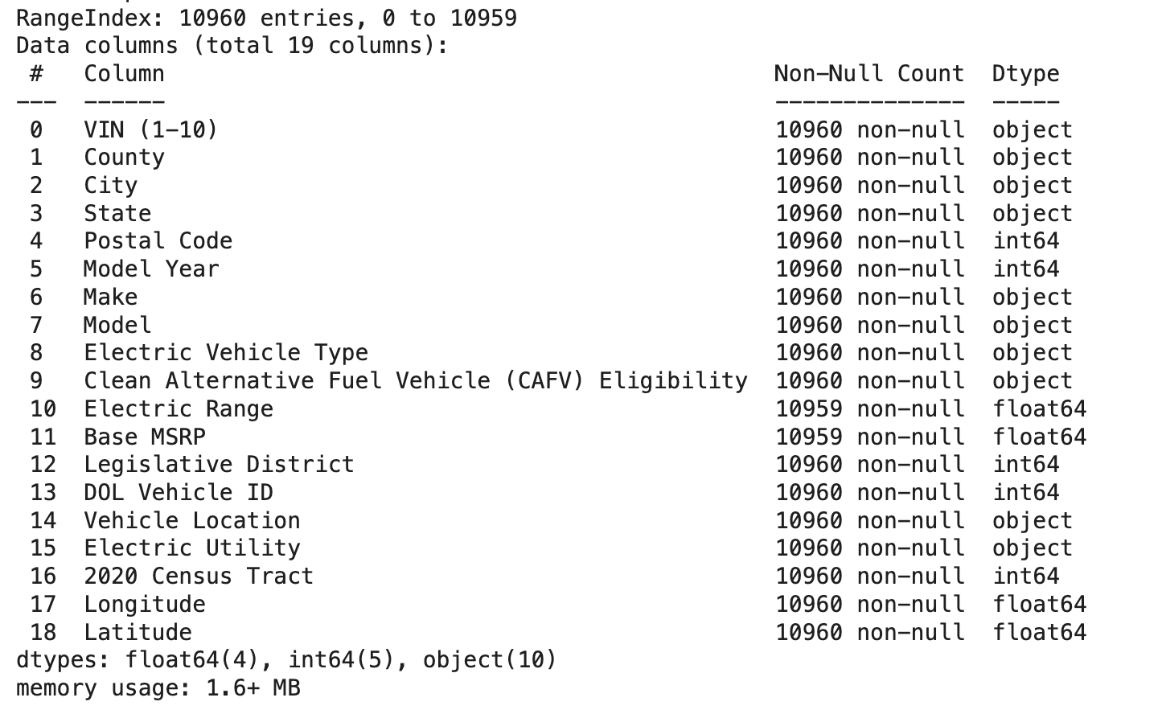
Dataset:
Electric Vehicle Population Data
The Battery Electric Vehicles (BEVs) and Plug-in Hybrid Electric Vehicles (PHEVs) that currently registered through Washington State Department of Licensing (DOL).
https://catalog.data.gov/dataset/electric-vehicle-population-data

Slide 6
Preprocessing
Dataset generated by data.wa.gov
Created in November 2020 and updated in October 2024.
Reduced the dataset to 10,000 records (10% of full dataset).
We first determined what data we had access to via ev.head().
From there we determined what type of data was in each column, object, floats, ints, etc.
We then checked for nulls, which there were none. Had there been any, we would have removed said data.
Notes:
Sean

Slide 7
Literature Review
Introduction to Electric Vehicles:
Environmental Impact and Efficiency:
Electric vehicles, including HEVs, PHEVs, and BEVs, are critical to advancing sustainable transportation. Unlike conventional vehicles, HEVs combine fuel and electric-drive systems, improving efficiency through regenerative braking
Argonne National Laboratory found that using electricity instead of gasoline as a fuel source reduces emissions by up to 53%. In various adoption scenarios, EVs could decrease greenhouse gas emissions by up to 36%, with HEVs and PHEVs potentially improving fuel economy by as much as 96% by 2045
Adoption and Challenges:
Data Analysis in Electric Vehicle Studies:
The high upfront cost of electric vehicles and limited charging infrastructure are notable barriers to widespread EV adoption. Government incentives, along with increased consumer awareness and education, are essential to overcoming these barriers and promoting EV ownership (International Energy Agency, 2020)
Data analysis of electric vehicle usage by region and vehicle type provides insights into adoption patterns. Using the Washington State Department of Licensing’s dataset, this study applied Python's Pandas library to explore geographic and demographic trends, revealing that urban areas with greater charging infrastructure see higher EV adoption rates
Notes:
Raj

Slide 8
Architecture & Methodology
We found the dataset on data.gov about electric vehicles registered in Washington State Department of Licensing.
This dataset identified different information about electric vehicles.
We analyzed the dataset with different factors.
We developed a Python notebook.
We started by doing Exploratory Data Analysis (EDA) to understand our data.
During that phase, we created histograms, distribution graphs, and graphic distribution graphs to understand the used of electric vehicles in Washington State.
Notes:
We created the dataset and identified 13 categories of impediments. We labeled the data using these classes. We developed a Python notebook. We started by doing Exploratory Data Analysis (EDA) to understand our data. During that phase, we created word clouds and histograms. We then created a BERT model to classify the impediments. We experimented with the model to improve the results. BERT is bidirectional encoder representation from transformers, a transformer-based machine learning technique for NLP. The reason why we used BERT is that we have a small amount of data. Transfer learning was thus necessary. BERT is pre-trained on huge datasets and it is one of the best models for text classification.
Sean

Slide 9
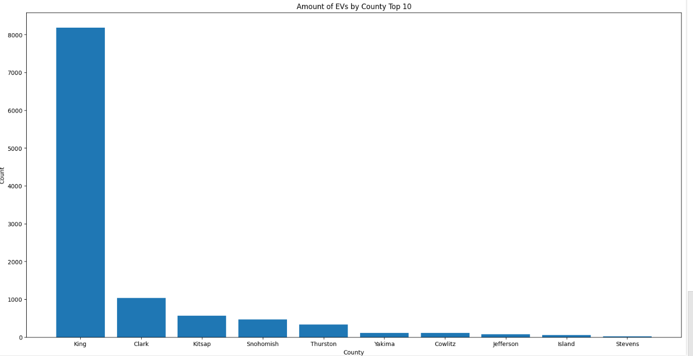
Result
Looks at the amount of EVs by county, top 10 only.
Notes:
Sean

Slide 10
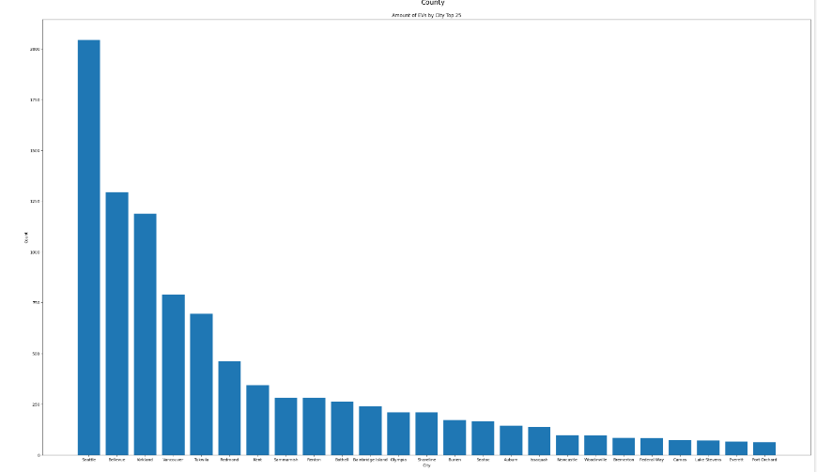
Result
Looks at the amount of EVs by city, top 25.
Notes:
Sean

Slide 11
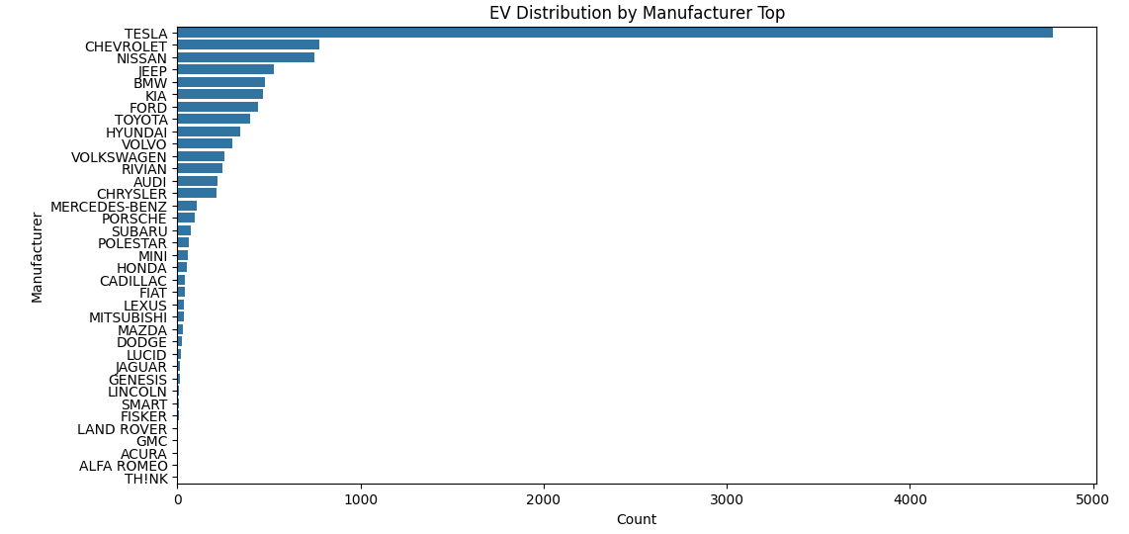
Result
This looks at the distribution of EVs by manufacturer.
Notes:
Sean

Slide 12
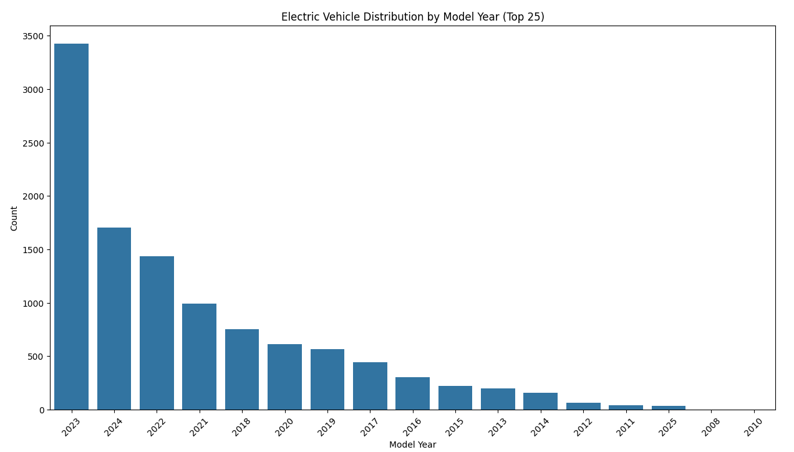
Result
This looks at the distribution of EVs by year.

Slide 13
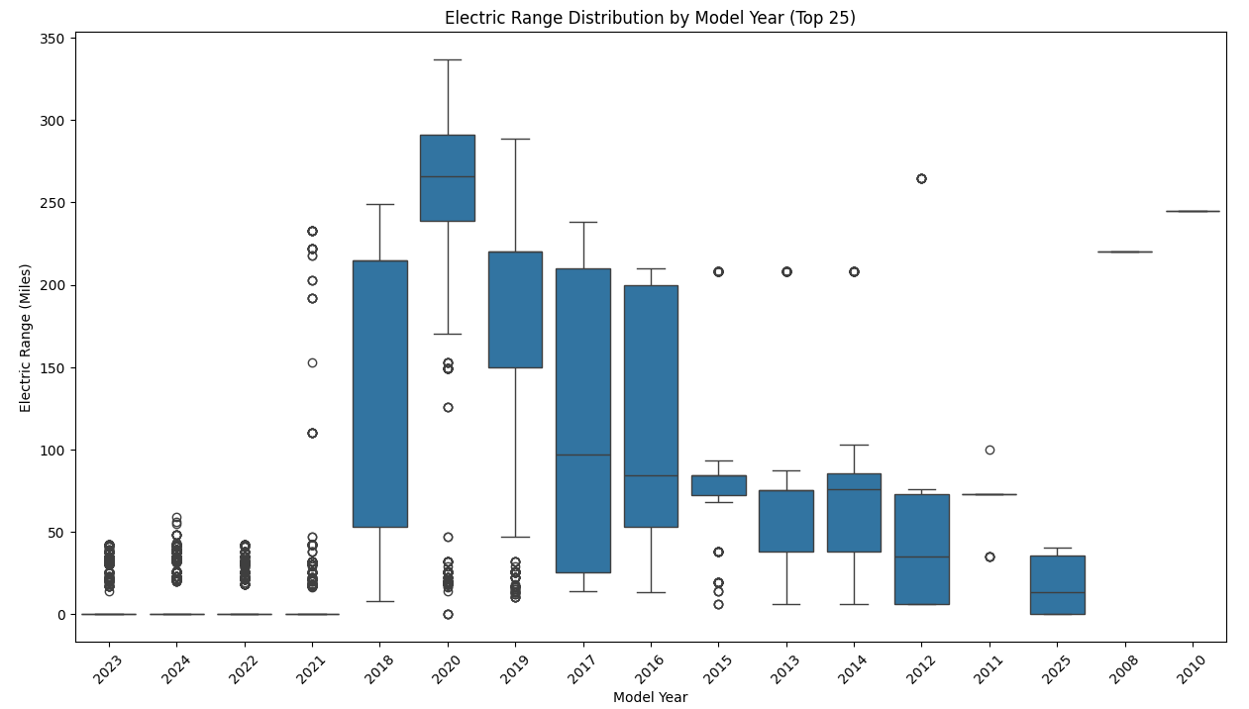
Result
This looks at the year an EV was produced and their range

Slide 14
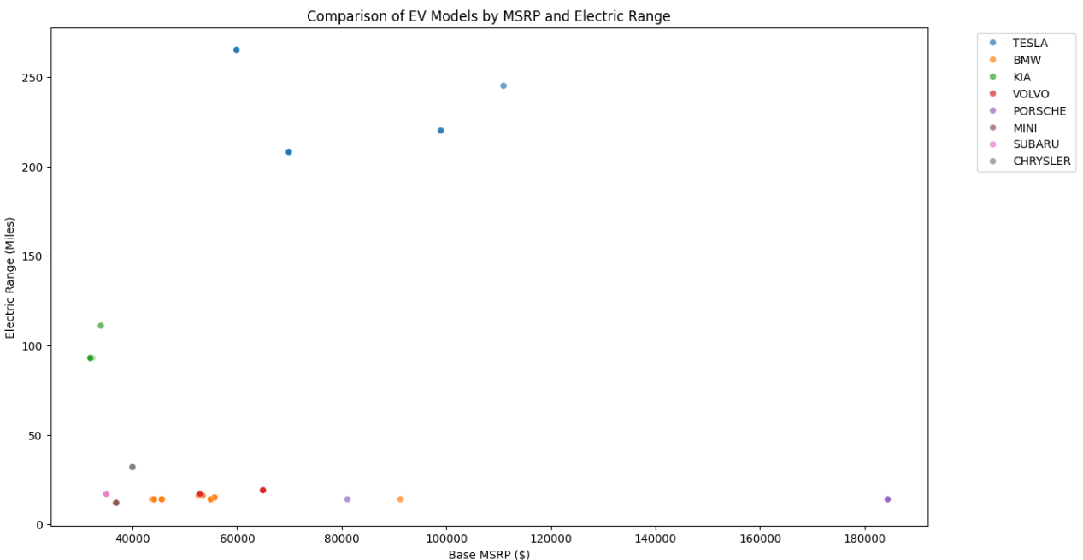
Result
Looks at the makes and models, with their base MSRP and their electrical range

Slide 15
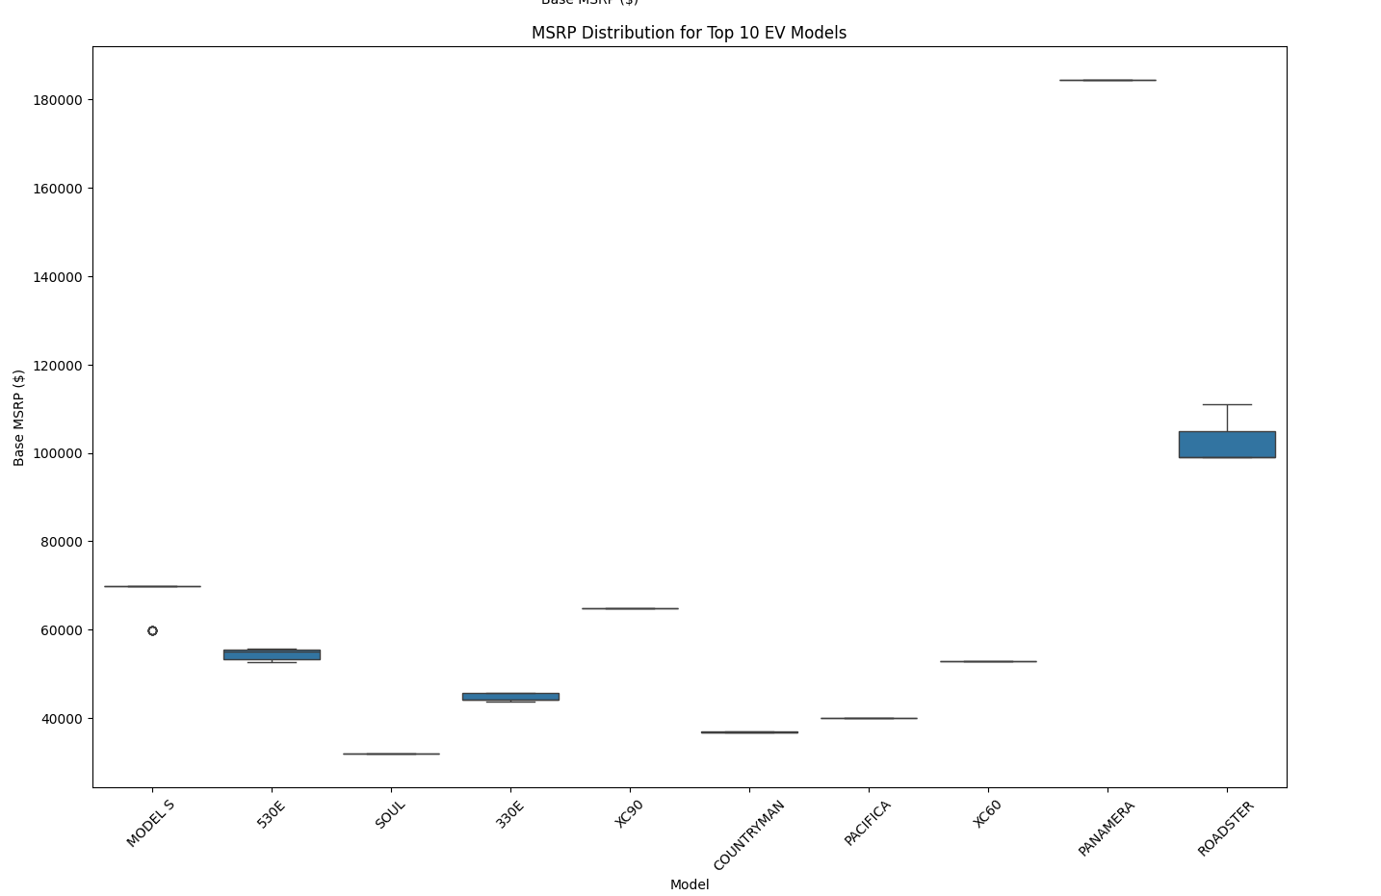
Result
Looks at the MSRP for the Top 10 EV models in Washington

Slide 16
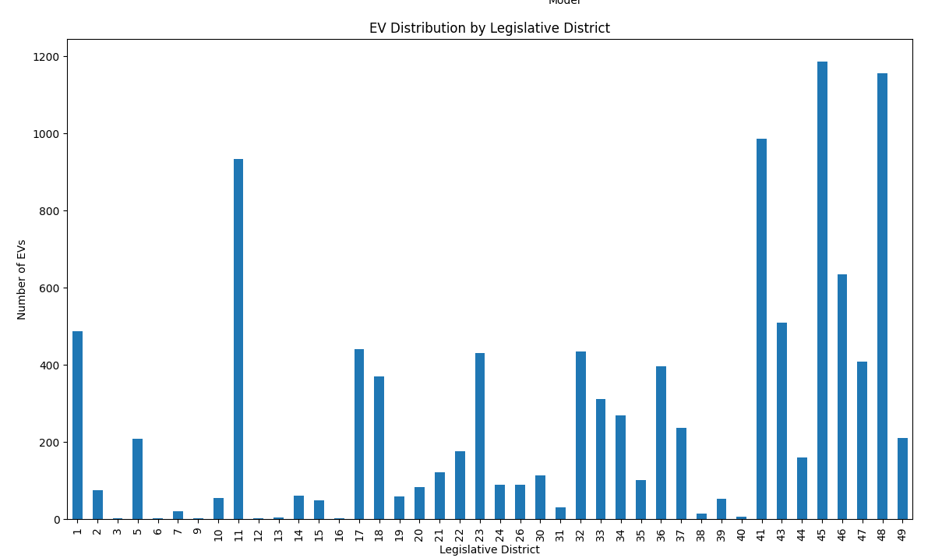
Result
Distributions of EVs by districts

Slide 17
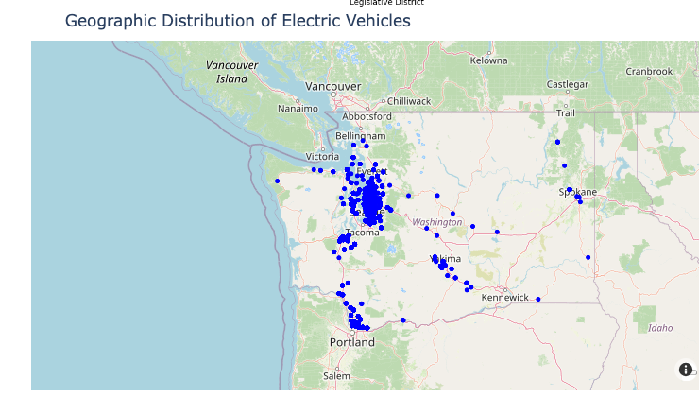
Result

Slide 18
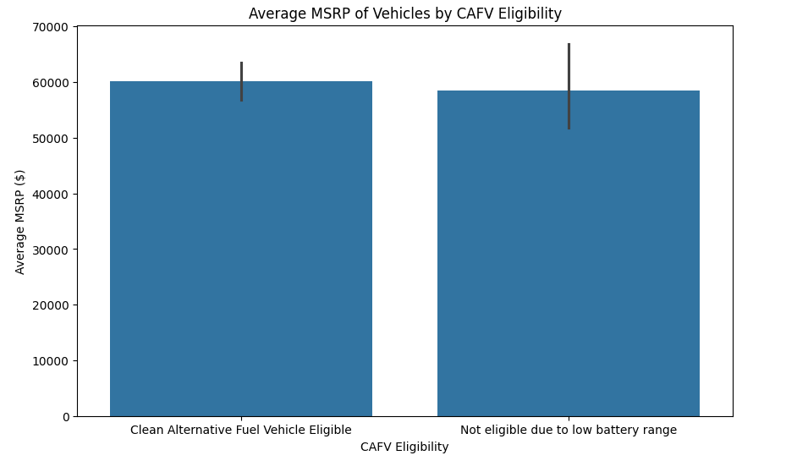
Result
Average cost of electrical vehicles and if the meet the Clean Alternative Fuel Vehicle eligibility

Slide 19
Conclusion
Our analysis reveals that EV adoption is concentrated in specific regions, likely influenced by local incentives and infrastructure. Key manufacturers dominate the market, offering a variety of models with varying electric ranges and prices. While higher-priced models generally provide longer ranges, clean fuel incentive eligibility is not limited to lower-priced vehicles, covering a broad range of models. This snapshot of the EV landscape highlights trends in adoption, pricing, and range, shaped by both consumer demand and regulatory support.

Slide 20
References
Data.gov. (2024, October 19). State of Washington - Electric vehicle population data. https://catalog.data.gov/dataset/electric-vehicle-population-data
Alternative Fuels Data Center: Electric vehicle benefits and considerations. (n.d.). https://afdc.energy.gov/fuels/electricity-benefits
International Energy Agency (IEA): The IEA’s Global EV Outlook 2023 report provides comprehensive data on electric vehicle adoption trends globally. https://www.iea.org/reports/global-ev-outlook-2023
U.S. Department of Energy, Argonne National Laboratory (ANL): According to ANL's AFLEET Tool 2023, EVs demonstrate significant greenhouse gas emission reductions, and fuel savings, particularly as the energy grid transitions to renewable sources.
https://greet.es.anl.gov/afleet
Alternative Fuels Data Center, U.S. Department of Energy (AFDC): The AFDC outlines the operational benefits of EVs, emphasizing cost savings, fuel efficiency, and reduced environmental impact. https://afdc.energy.gov/fuels/electricity_benefits.html

Slide 21
GitHub Repository Code
https://github.com/KaiyinCh/ElectricVehicle

Slide 22
Thank You!

